Slide 1
Intel Cloud Security Practicum
Sponsor - Intel Point of contact - Jonathan Buhacoff, Eric Gee Faculty Advisor - Patrick Tague Team BlueChip - Deepti, Divya, Marcelo, Rashmi
INI Project Practicum, Fall 2014

Slide 2
Agenda
Project overview
Technology overview of BOAT (Barbican OAT)
Architecture Overview
Process + Dataflow
Progress status on BOAT
Expectations
Implementation progress
Project progress health
Project timeline
Plan for the rest of project

Slide 3
Project overview
In this project, we aim to develop an open source model that integrates Barbican (key management) and KMIP Server (key storage) with Intel-OpenStack trust attestation server OpenAttestation for trusted computing on cloud infrastructure.

Slide 4



Problem statement
Computer Node
Secure remote attestation of CN
Secure image, only the CN can open the image
Each image needs a secret
Secret generation? Key management? How to share secrets?

Slide 5
Open Source alternatives
OpenStack: IaaS implementation
Control pools of processing, storage and networking
Nova: Manage and automate compute resources (Amazon EC2)
Cinder: Block storage (Amazon EBS)
Barbican: REST API for key management
KeyStone: Authentication and authorization
OAT: OpenAttestation
Intel Project
REST API for remote attestation
KMIP: Protocol for Key Management
KMIP Server: Store and control secrets

Slide 6
OpenStack Barbican
Barbican is a REST API which provides secure storage, provisioning and management of secrets. It can handle many types of secrets, including:
Symmetric Keys
Asymmetric Keys
Raw secrets
Barbican fits into Intel’s Trusted VM solution model as a key management server, which stores keys and provisions requesting cloud servers with keys based on their trust and policy compliance as attested by trust authority OAT.

Slide 7
BOAT Architecture Overview
CSP
Cinder
Agent
Client Side
Trusted CN
Untrusted CN
Client
Keystone
Barbican
OAT Server
KMIP

Slide 8
BOAT Process - Key Generation
Cinder
6. Encrypted VM, key ID
Client requests for symmetric key with some required specifications to Barbican server
Barbican server requests KMIP Server to create symmetric key with given specifications
KMIP Server creates the key and sends the key and key_URL to Barbican
Barbican creates key_ID for key mapped to key_URL and sends key+key_ID to Client
Client encrypts the VM with key from Barbican and sends key_ID in metadata
Agent
5. Encrypted VM, Key ID
Client Side
Client
1. Request
Keystone
Barbican
4. Key, keyID
3. Key, keyURL
2. Request
KMIP
Notes:
Data flow here
Arrow text will be changed once the dataflow is added

Slide 9
BOAT Data Flow - Key Generation
Client Barbican Server KMIP Server Cinder Trust Agent
[AES Key Request + Key Spec]PubKey_{barbican}
[AES Key Request + Key Spec]PubKey_{KMIP}
[AES Key + Key_URL]PubKey_{barbican}
[AES Key + Key_ID]PubKey_{client}
Encrypted VM, Key_ID
Encrypted VM, Key_ID

Slide 10
BOAT Process - Key Request & Trust Attestation
Agent sends request for key of given Key_ID to Barbican server along with AIK of requesting Compute Node
Barbican server sends the AIK to OAT to verify if node is trusted and complies with Client Policy.
If trusted, OAT sends Trusted_flag set to TRUE along with Bind Public Key of Trusted Compute Node
Barbican requests for key of Key_ID/Key_URL to KMIP Server
When KMIP retrieves the key from storage, Barbican Server encrypts it with PubKey of TCN and sends to the Agent.
CSP
Agent
1. Key ID, AIK
Trusted CN
Untrusted CN
8. Key
KeystoneBarbican
3. Request for measurements
4. Measurements
2. Attestation Request, AIK
6. Key request, Key ID
7. Key
OAT Server
5. Trusted Flag, PubKey_{CN}
KMIP

Slide 11
BOAT Data Flow - Key Request & Trust Attestation
Trust Agent Barbican Server KMIP Server OAT Server
Key_ID, AIK_{TCN}
[AIK_{CN}]PubKey_{OAT}
[Trusted_Flag=Y, BindPubKey_{TCN} ]_{barbican}
[Key_ID]_{KMIP}
[Key]_{barbican}
[Key]_{TCN}

Slide 12
Milestone 1 Expectations
Research on plugin support for intercepting key request with trust attestation.
Research on plugin support for KMIP server in backend
Start setup of systems in model
Barbican server
OAT server
Finalize a technique for SSL support Authentication of client and barbican

Slide 13
Milestone 1 Progress - Research
We did a study on plugin support for Openstack Barbican and have made the following design decisions:-
KMIP backend support
New plugin called kmip_secret_store, exists in Barbican project.
KMIP Server open source implementation, KMIP4J
Trust Attestation plugin support
Openstack project Stevedore, to manage dynamic plugins
We will create our plugin for Trust Attestation by OAT
SSL support for Barbican
Keystone authentication with OAT CA

Slide 14
Barbican plugin for Attestation & KMIP
Barbican currently uses SteveDore plugin to interface with cryptographic resources.
It is possible to use these plugin interfaces synchronously or asynchronously to call external services.
In our case, the external service will be OAT server
We are still looking into how this plugin design will fit into our architecture

Slide 15
KMIP
Key Management Interoperability Protocol
Standard for communication between encryption systems
OASIS protocol
TLS support
Client request for creation, store or retrieve objects:
Symmetric keys, Certificate, private key, public key
Objects has attributes: Protocol, length, activation date, deactivation date
Operations: creation, register, get, revoke, certificate, destroy,...
KMIP Server: Implementation is not defined in the standard.

Slide 16
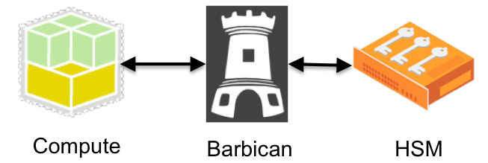
Barbican support to KMIP
Blueprint Oct 2014
Barbican already support KMIP
Plugin kmip_secret_store.py
Secret Store implementation (The secret store interface will support the basic functionality of a secret store.)
PKCS#11
PKCS#12
KMIP
KMIP server
KMIP4J

Slide 17
Milestone 1 Progress - Setup
OAT
Installed maven for building projects, openssl to generate RSA keys
Created an attestation server
Created RSA keys for use by Trusted node later
KMIP
Provisioned KMIP4J server
Run a local database based on H2

Slide 18
Milestone 1 Challenges - setup issues
OAT
Project build failed multiple times for reasons unknown.
Required specific version of javac compiler and even right version did not work.
While the maven project tried to invoke another build, it continuously failed at multiple points.
Had to manually build other projects.
KMIP4J
Server deploy depends of Eclipse - Ant configuration. Decoupling did not work

Slide 19
Milestone 1 Challenges - Architecture
Agent implementation monitoring Trusted compute node, Untrusted compute node.
OAT communication with compute nodes for measurement verification
Encrypted Image provisioning from Client to compute node via Cinder on cloud service provider.

Slide 20
Project timeline
Description | Milestones | Progress | Deliverable | Completion Date
Research on OpenStack Barbican for plugin and KMIP support | Milestone 1 | Close to completion | *Progress Report v1.0 *Progress Presentation *Setup | 11-06-2014
Creation of plugin for attestation & key wrapping | Milestone 2 | Not Started | *Progress Report v2.0 *Demo of plugin | 11-20-2014
Plugin Support for KMIP server | Milestone 3 | Not Started | *Technical Report *Final Presentation *Final Demo | 12-05-2014

Slide 21
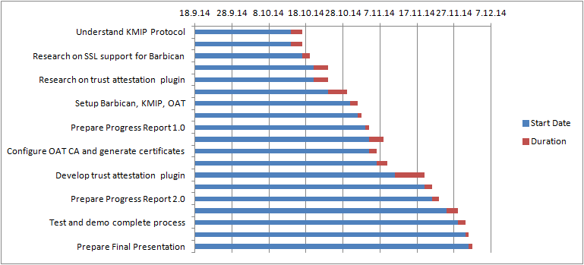
Plan for the rest of project

Slide 22
References
http://www.intel.com/content/dam/www/public/us/en/documents/white-papers/creating-trust-in-cloud-ubuntu-intel-white-paper.pdf
https://wiki.openstack.org/wiki/Barbican/Discussion-Plugin-Design
http://docs.openstack.org/security-guide/content/identity.html
https://github.com/openstack/barbican/blob/210c7a9691e5fbed6cd83423141b36407ff6d4d5/barbican/plugin/kmip_secret_store.py
https://wiki.openstack.org/wiki/KMIPclient
http://docs.openstack.org/developer/barbican/plugin.html
https://github.com/openstack/stevedore

Slide 23

Questions?

